Slide 1

Prison and public libraries working together
Setting the Scene

Slide 2
International guidelines
IFLA International Guidelines for Library Services to Prisoners 2023
10.1 Prison libraries should not operate in isolation but should cooperate with other local libraries where possible. Where public library services operate in the same geographic area as a correctional facility, the two should attempt to form a collaborative relationship with the other. Apart from ensuring professional and modern library management, this enables prisoners to experience a public service that they can continue using once they are released. Prisoners remain members of the local community and according to the IFLA-UNESCO Public Library Manifesto 2022, the local library continues to be responsible for serving them.
https://www.ifla.org/news/new-ifla-guidelines-for-library-services-for-prisoners/

Slide 3
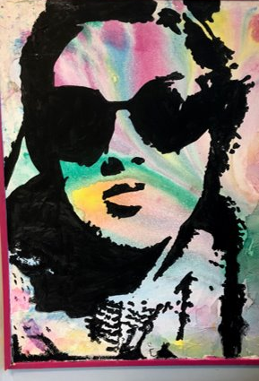
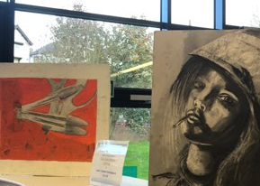
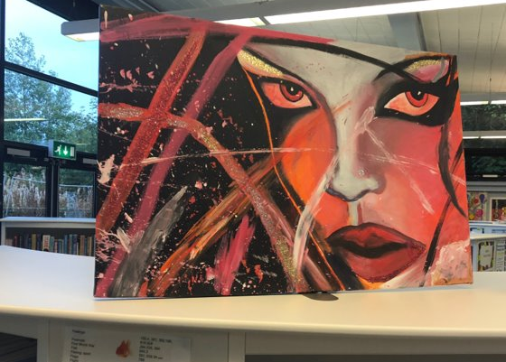
Art exhibition, Hydebank secure college
Collaboration between Hydebank Wood College and Newtownbreda Public Library
Prisons as “part of the community, not apart from the community.”

Slide 4
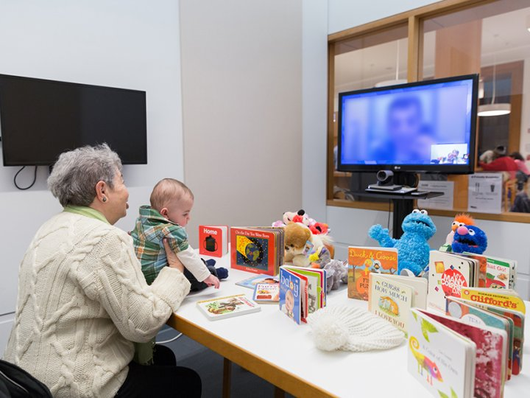
Telestory, Brooklyn public library
Provides a safe space for parents and children to talk and read together
Digitally inclusive initiative
Aims to reduce stigma of having a parent in prison
https://www.urbanlibraries.org/innovations/telestory-library-to-jail-video-storytime

Slide 5
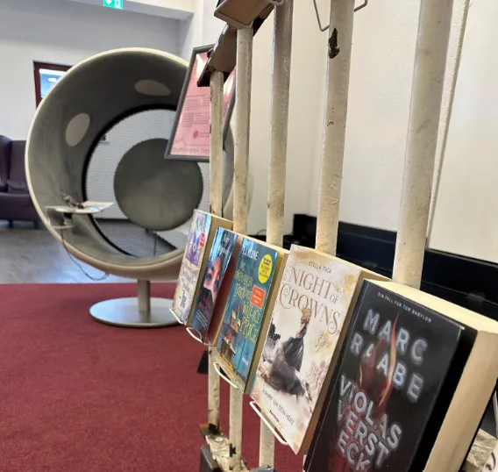
Prisoner book reviews, germany
Collaboration between Siegburg Correctional Facility and Siegburg Public Library
Book reviews are turned into podcast episodes
Designated area in the public library to listen to podcast and borrow reviewed books
https://www.uil.unesco.org/en/articles/book-reviews-prisoners-germany

Slide 6

Prison and public libraries working together

Slide 7
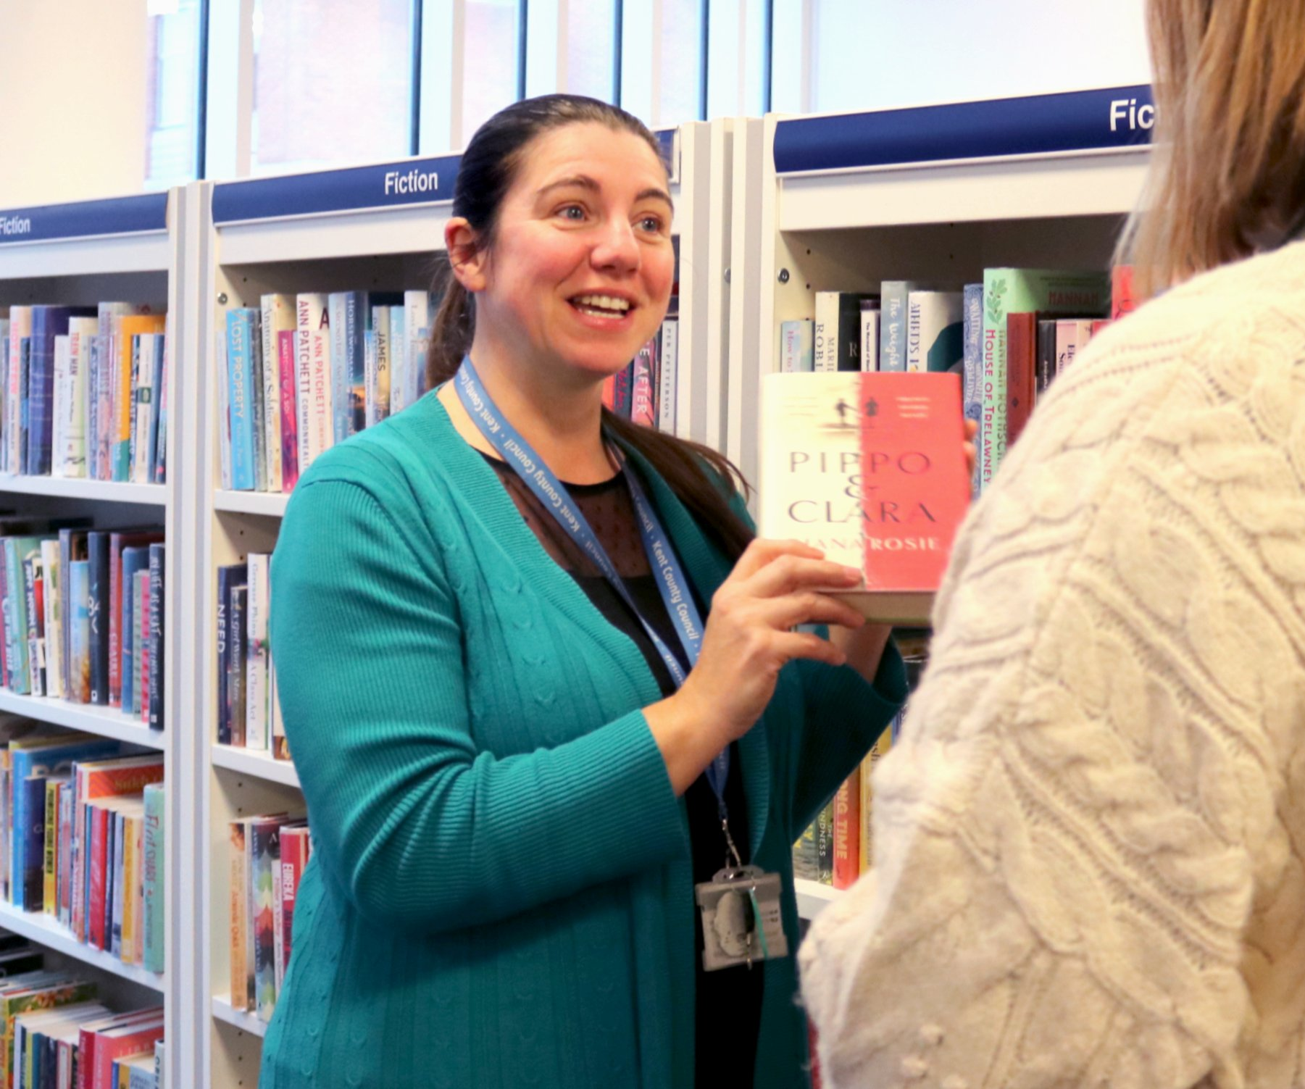

Training and connection
Work-shadowing in public libraries, and prison libraries
Including prison library staff in the public library team for meetings, bulletins and initiatives
Prison staff having regular working time in the public library, and access to the same staff training as the staff in the public libraries.

Slide 8


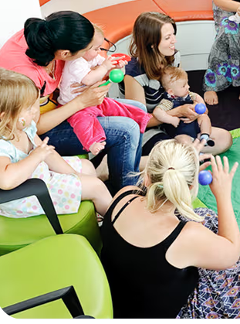
Family projects
Importance of family ties – for wellbeing, rehabilitation and re-connection with society on release
Sending information about library services to families with Storybook Dads CDs and Raising Readers books
Including prisons in the Summer Reading Challenge
Shared reading and the benefits to the prisoner and their children

Slide 9


Leaving prison as a library user
Many prisoners are first-time library users
Engaging with prisoners to encourage use of the public library post-release, promoting the benefits.
Providing information about local public libraries for their release area.
Creating a recognisable library inside the prison to mirror the outside library

Slide 10

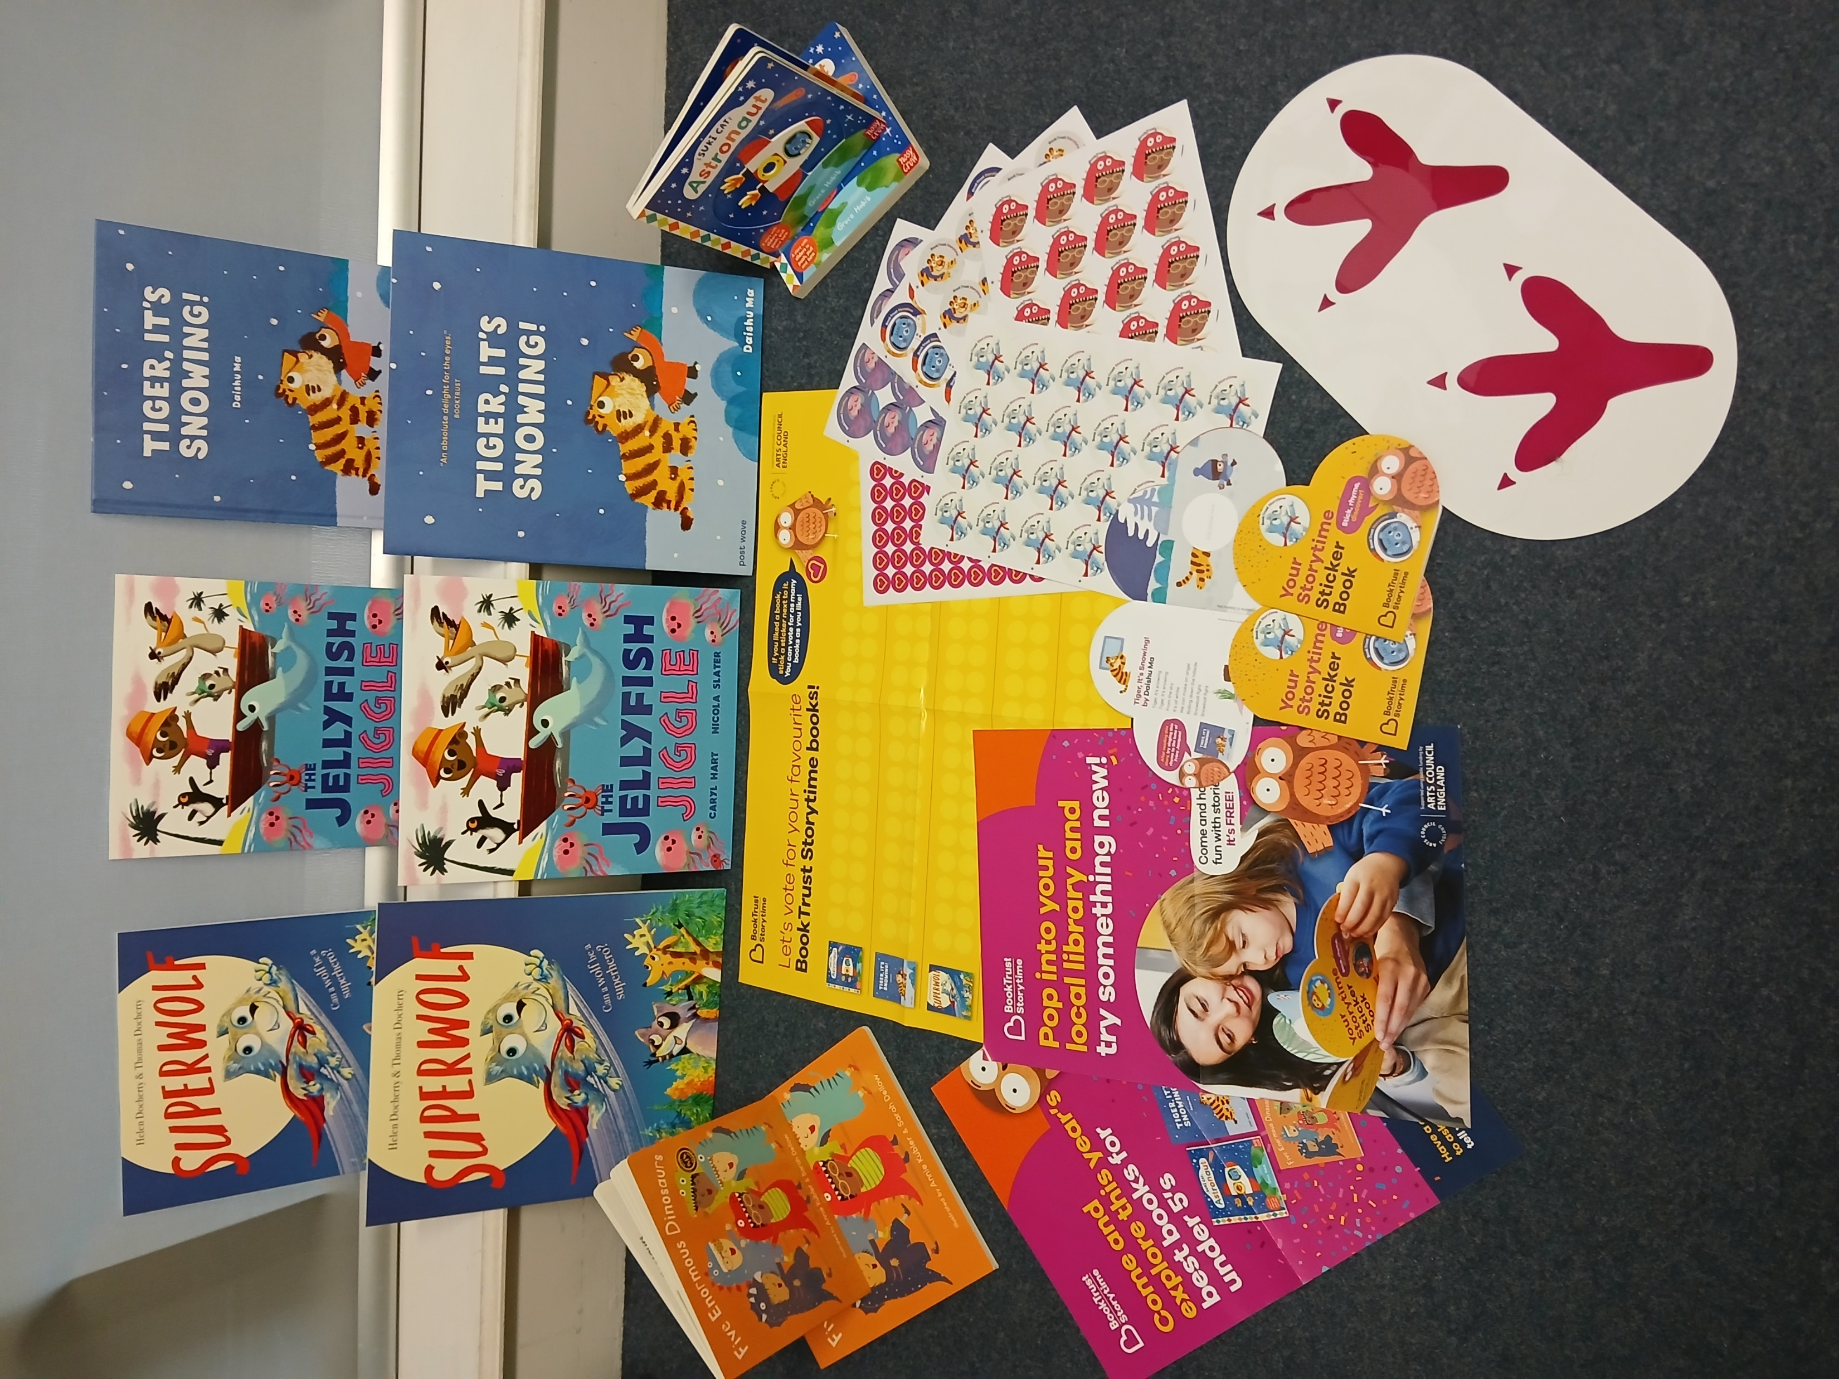
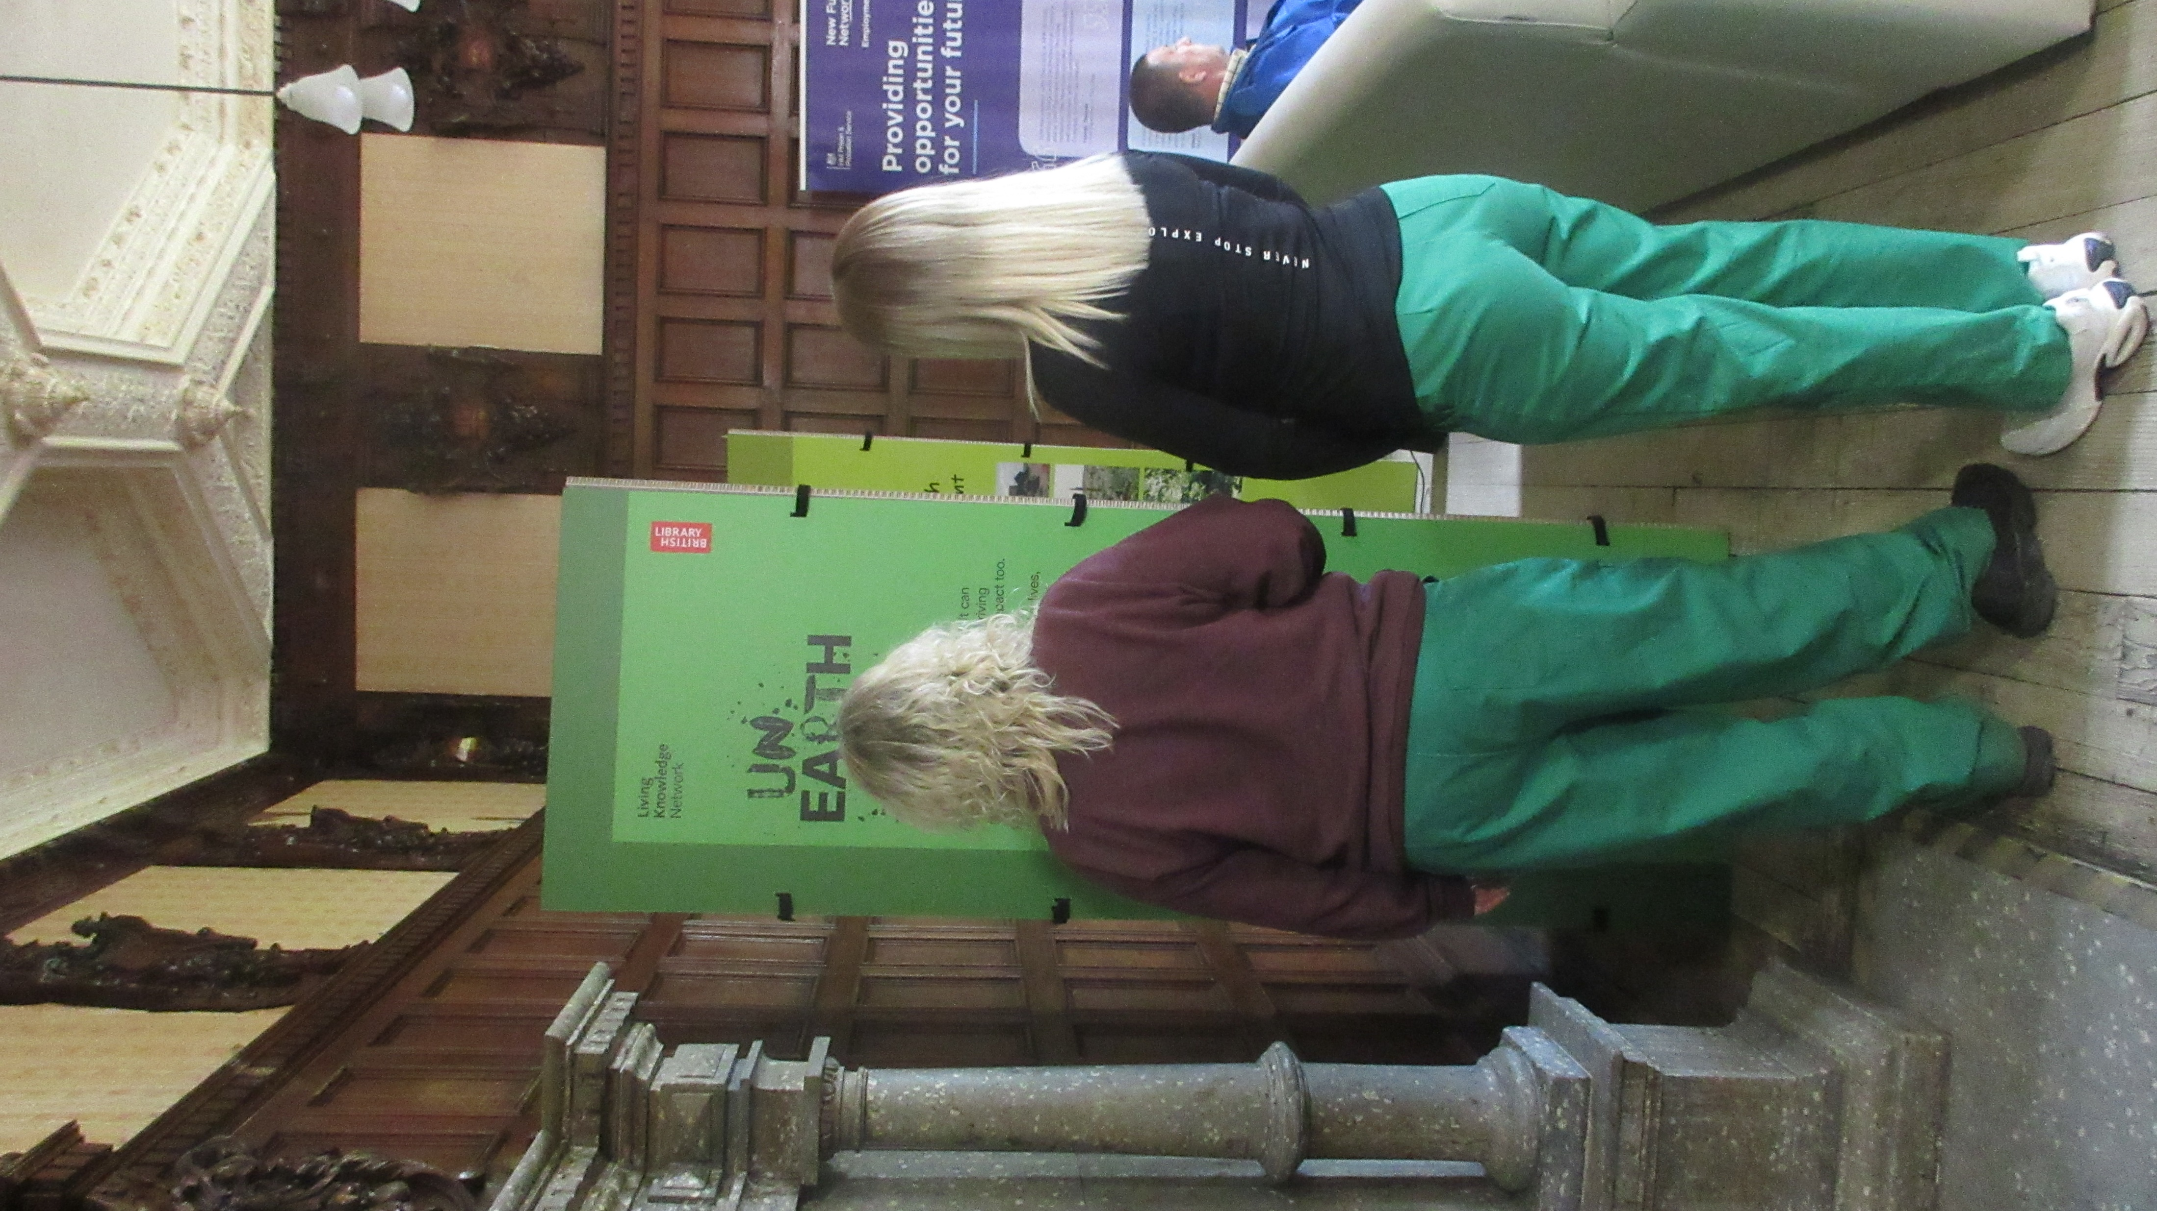
Mutual projects
Many public libraries run projects that would work in a prison setting
Sharing of resources, information, and know-how with prison library staff
No need to for prison library staff to waste time and resources to invent new activities if they already exist in the public library

Slide 11
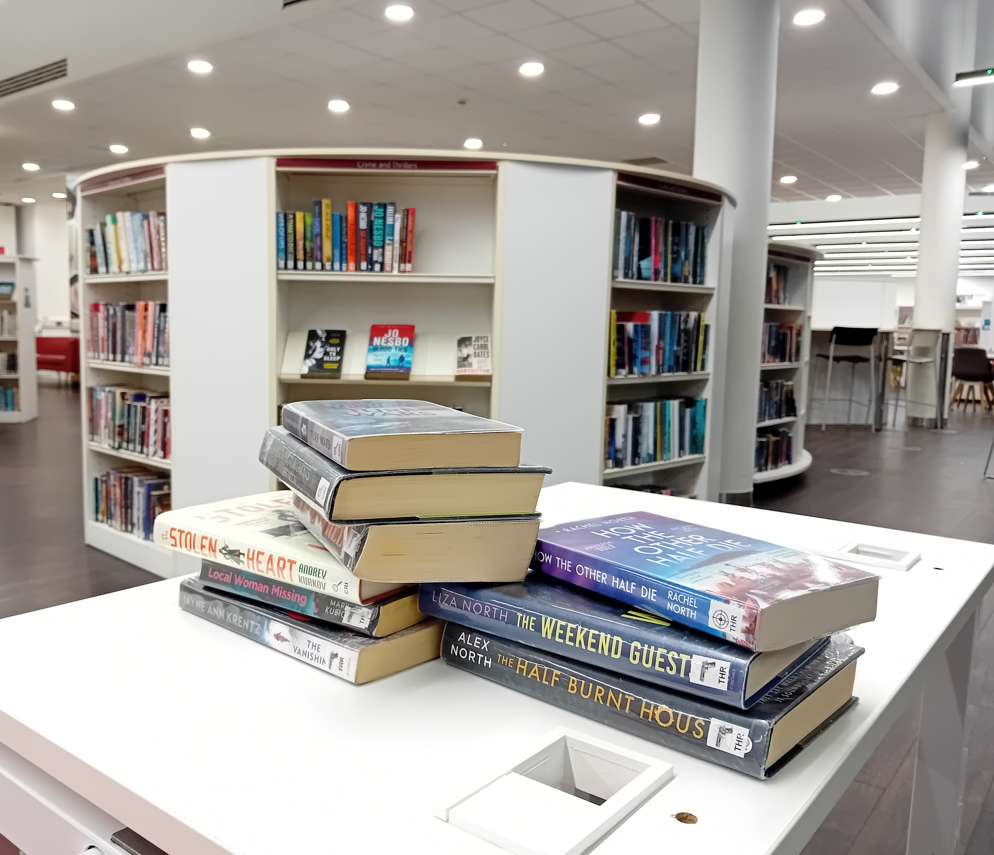
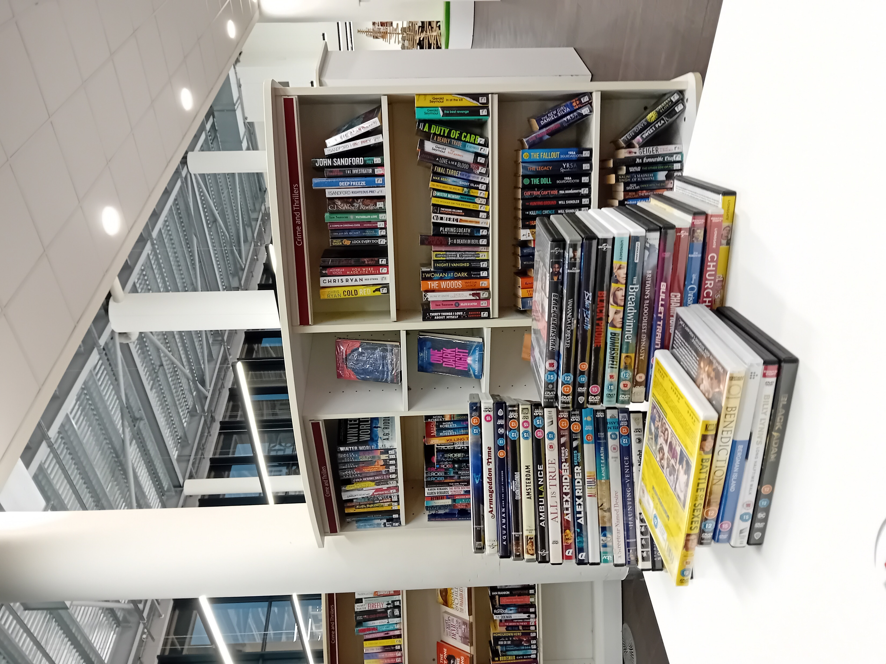
stock
Reservation service for stock from public libraries widens access and improves stock availability. It works both ways in Kent so county residents also benefit from access to stock that might not be in the public library.
Creation of a stock policy that includes sending appropriate weeded stock to prison libraries

Slide 12

Employment
Employment opportunities for ex-prisoners or serving prisoners in public libraries
In Kent a serving prisoner in an open prison works part-time in the public library on day-release.

Slide 13
Benefits of collaboration
Benefits for people in prison:
Community connection: Shared reading initiatives, feeling part of community, reducing stigma, maintaining positive family ties
Widens access to library resources, services and initiatives to help with wellbeing, reading confidence, literacy, digital literacy
Continuity: Familiarity with public library services, encourages use after release
For families and communities:
Family connections: Shared reading initiatives strengthen parent–child relationships
Empathy & Awareness: Raises community understanding of the challenges faced by families, reduces stigma

Slide 14
Benefits of collaboration
Benefits for libraries and library staff:
Reduced isolation and increased professional support for prison library staff: Closer links with public library colleagues, shared expertise, training opportunities
Professional development for public library staff: Builds staff expertise in partnership working, increases empathy and knowledge of how to work with justice-impacted communities
Social impact: Demonstrate libraries’ role in tackling inequalities and serving marginalised communities
Advocacy and recognition: Initiatives can sraise profile of both prison and public librarie

Slide 15
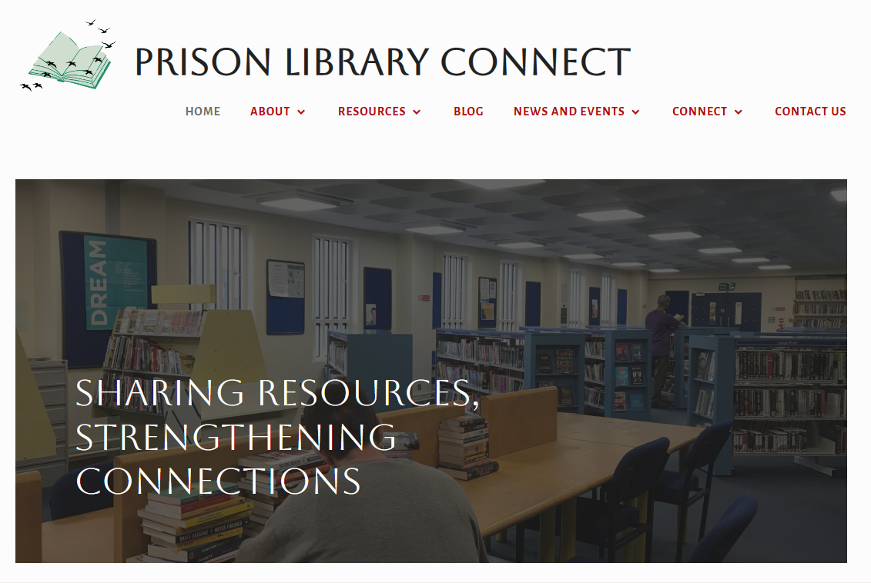
Sharing ideas

Slide 16
Group discussion

